Slide 1
Running Tensorflow in Production: Challenges and Solutions on YARN 3.x
Wangda Tan

Slide 2

About me
Wangda Tan
Engineering Manager of YARN team @ Hortonworks.
Apache Hadoop PMC member and committer, working on Hadoop since 2011.
Major working field: scheduler / deep learning on YARN / GPUs on YARN, etc.

Slide 3
Agenda
Basics for deep learning
Journey to production-ready deep learning.
Solution with YARN 3.x.
How Hadoop Submarine project helps.
Other interesting points / data

Slide 4
Basics for deep learning

Slide 5
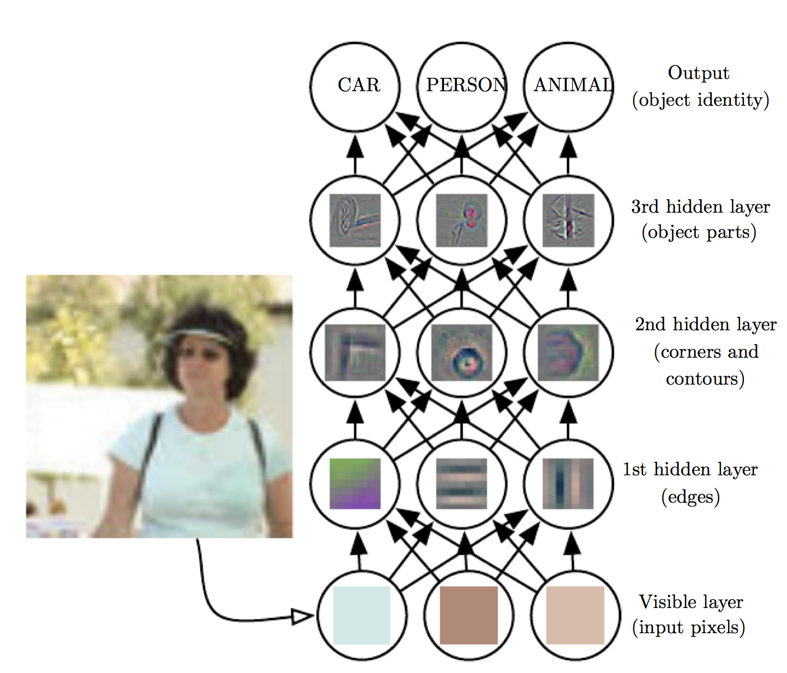
What is deep learning
Deep Learning, Ian, et al.

Slide 6
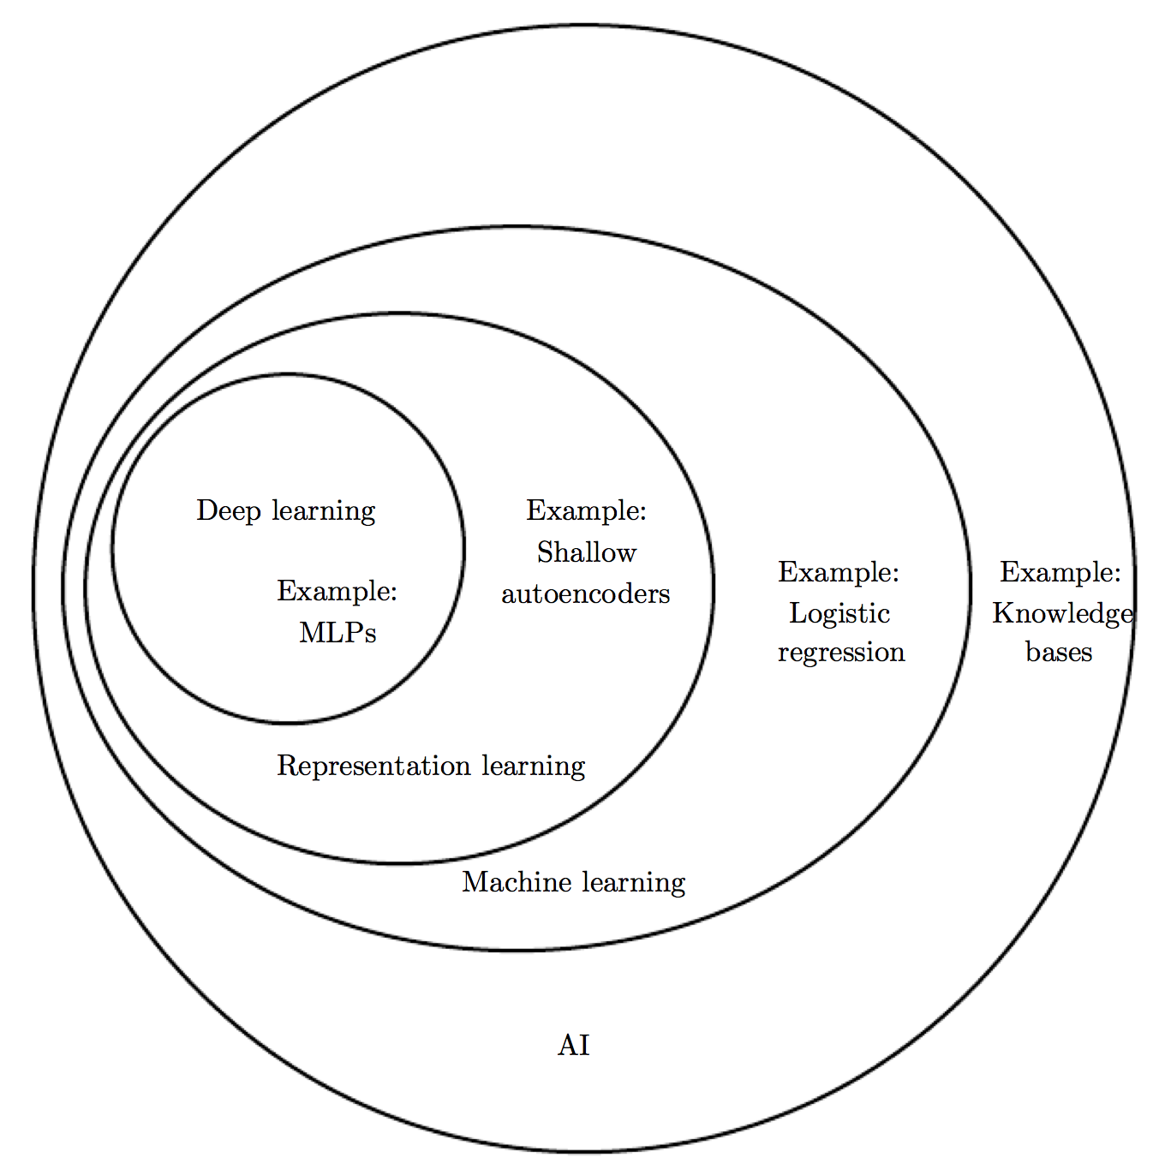
AI universe
Deep Learning, Ian, et al.

Slide 7
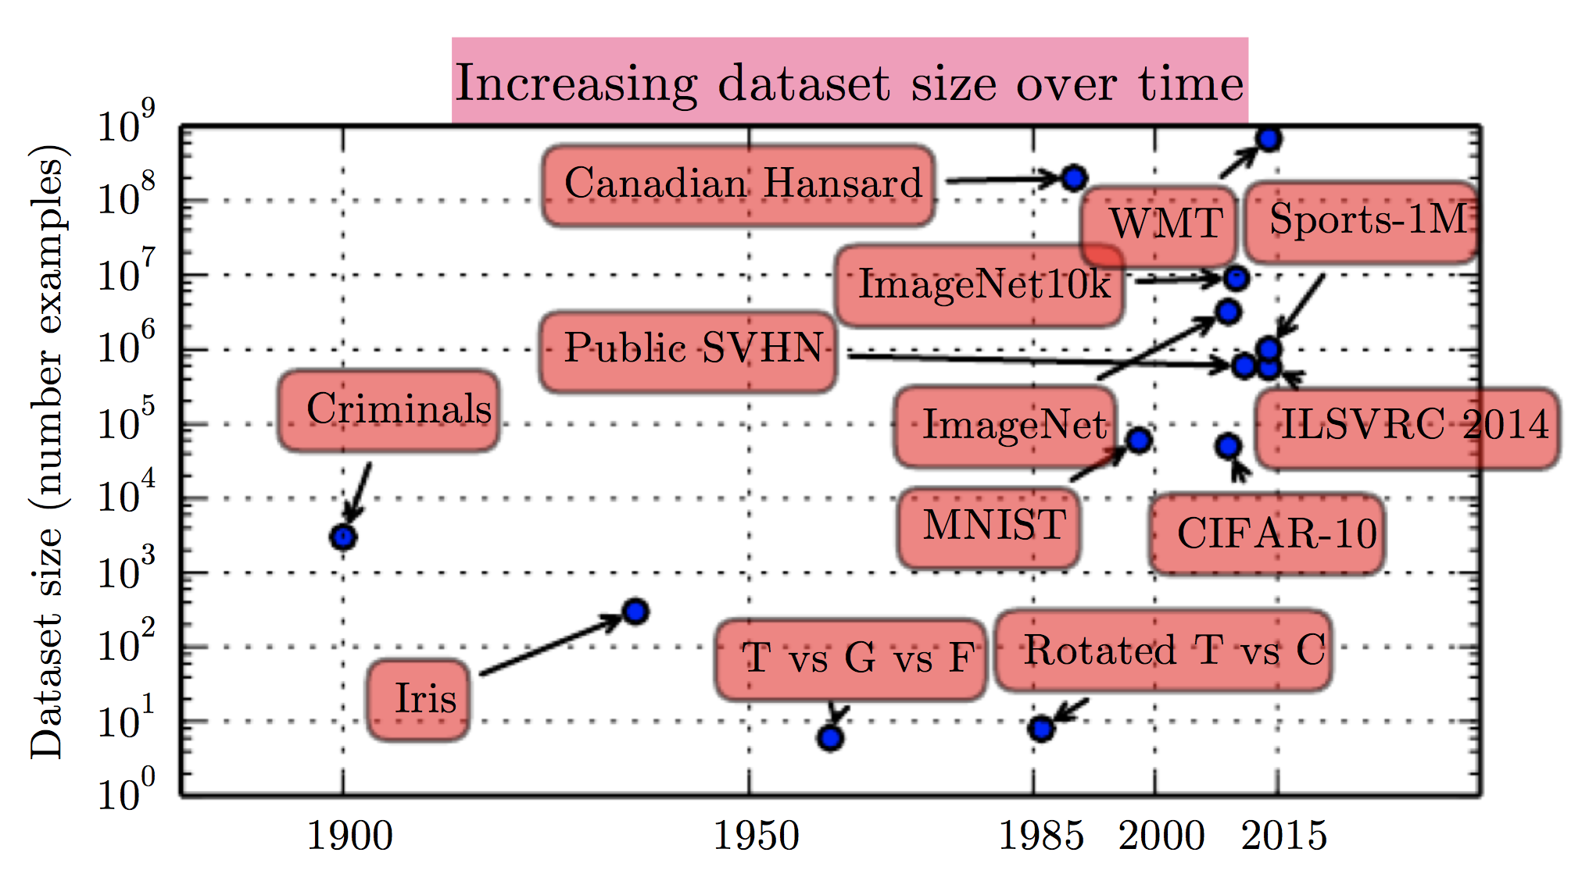
Trend 1: Data set size
Deep Learning, Ian, et al.

Slide 8
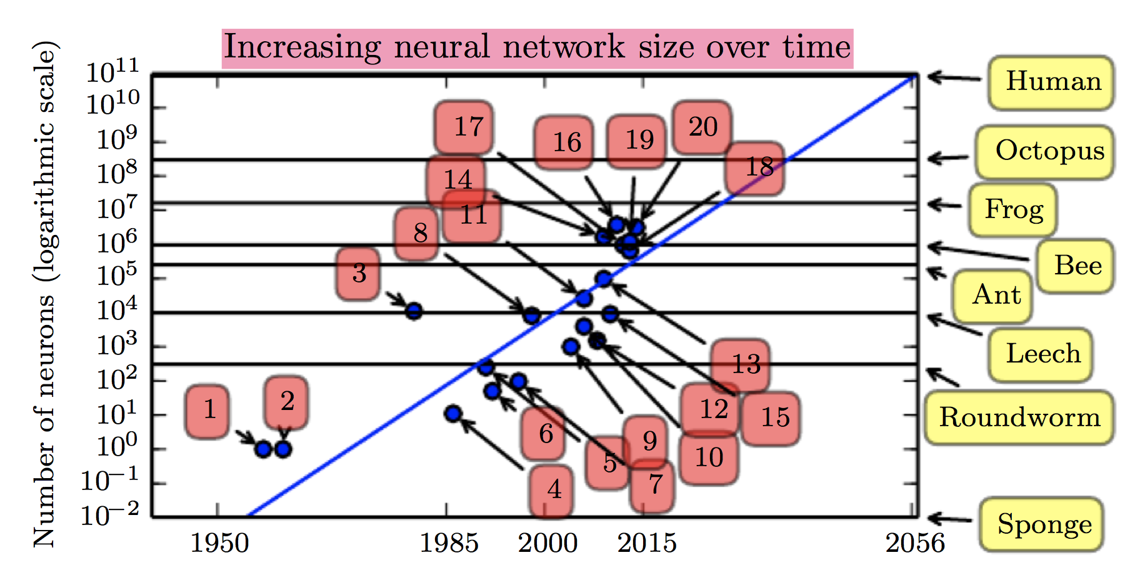
Fact: Neural network size by species
Deep Learning, Ian, et al.

Slide 9
Journey to production

Slide 10
The story begins
One day, your were asked by your mgr to develop machine learning models to predict xyz:

Slide 11

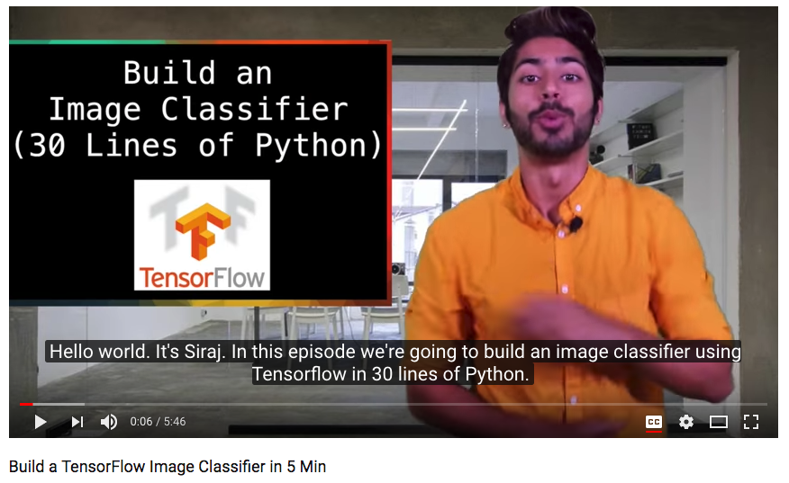
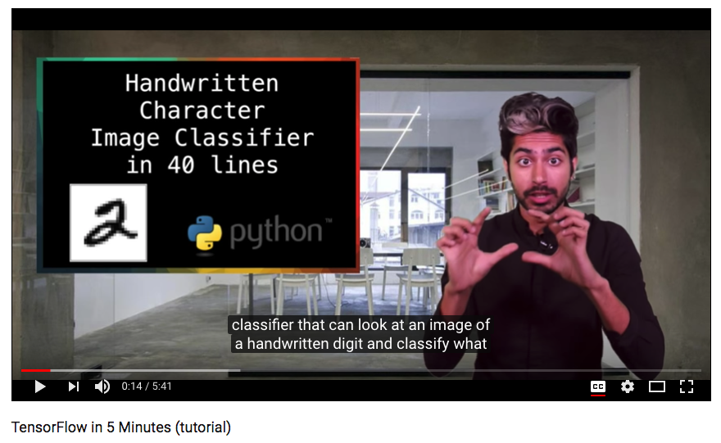
The story begins
Until you found some videos helps you quick-start ..

Slide 12
Once you get started, you will find:
CPU is like

Slide 13

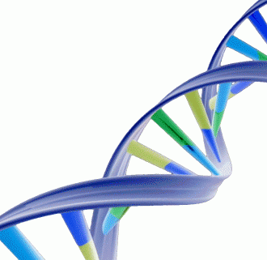
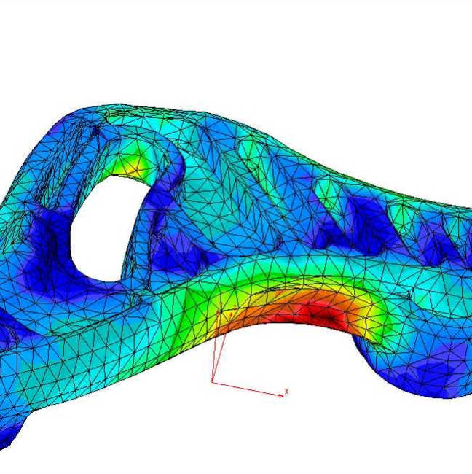
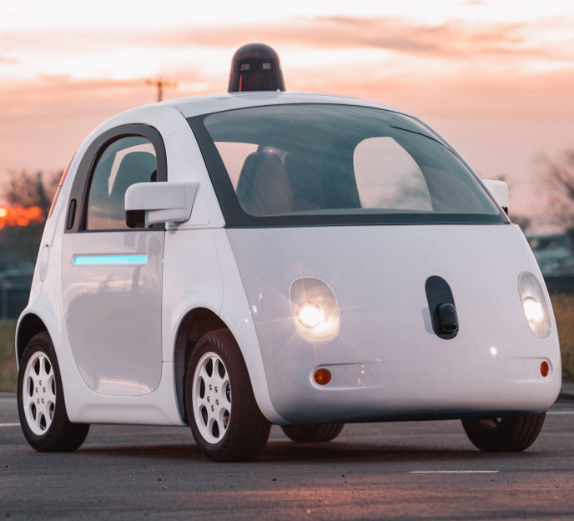

Why GPU? (1)
GPU can speed up following computation-intensive applications 10x - 300x times
Gene Analysis
Scientific Computation
Without GPU speed up, you will almost
impossible to do these computations. (If job
runs for weeks).
Self-Driving Car
Deep learning

Slide 14
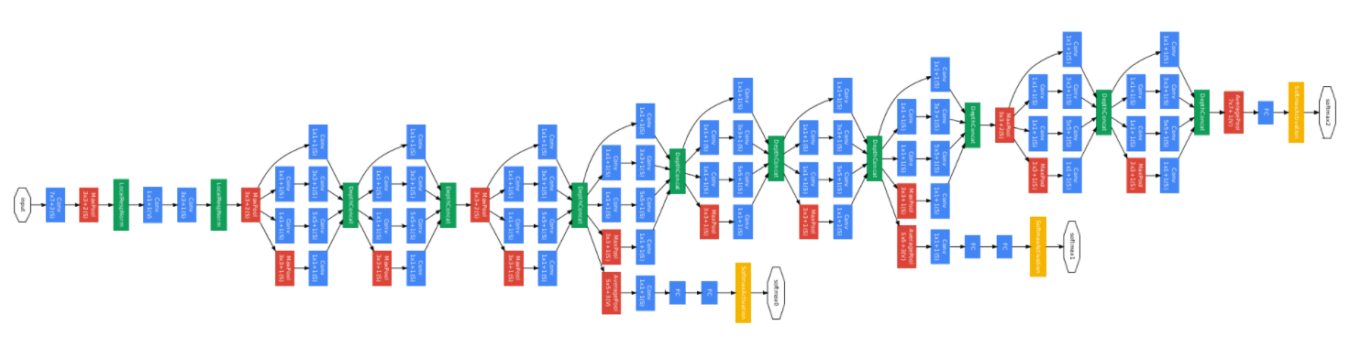
Why GPU? (2)
GPU: Many cores to handle massive (but simple) computation tasks simultaneously:
Nvidia Tesla K40:
2880 CUDA cores.
$2265.00 => $0.78 / core
Intel Xeon E5-2697
14 cores
$2295.00 => $163 / core
GPU
CPU
Computation Intensive
Other

Slide 15
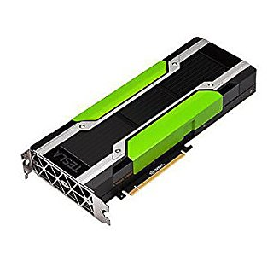
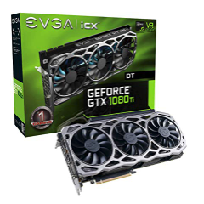

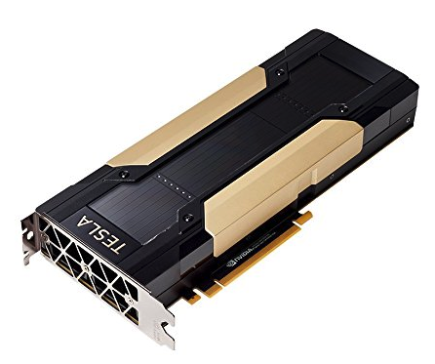


Once you get started, you will find:
CPU is like
Assume you got all these ..

Slide 16

And soon, you will compete with others ..
Everything is over ..
Run job
DS1
Run job
DS2

Slide 17
And soon, you will compete with others ..
Not only for resources, but also for dependencies
Job1: Tensorflow 1.8.0, CUDA 9.x, CUDNN 7.x
Job2: Tensorflow 1.4.0, CUDA 8.x, CUDNN 6.x
What should we do?
Assume you got all these solved ..

Slide 18
And soon, you will find deep learning is not the only thing
Assume you have user information in tables like
Browser history
Purchase history
Country
ID
You want to extract data for training
Sampling, ETL, feature extraction, etc.
Sounds familiar? Yes! You need your favorite ETL tools to do this, which need to access the same data lake
Assume you got all these solved ..

Slide 19
And soon, you need to train production-ready models
Many hyper-parameters need to be tuned.
How many hidden layers.
Activation functions.
Loss functions.
How to do data normalization/transformation.
How to quickly iterate experiments -> production.
Do experiments in an interactive env, and run production jobs regularly.
Model serving/management
Online service / batch prediction
Now you can be more enjoyable more

Slide 20
Lots of contents, let’s recap challenges
Handle data access.
Do ETL efficiently.
Handle job dependencies.
Multi-tenant.
Do experiments easily.
Run production jobs easily.
Manage models
DL issues.

Slide 21
With YARN 3.x, What can be done

Slide 22


Why all under YARN
SLA!
Capacity Planning, Preemption, Reservation System.
Monitoring!
Time time services, Grafana, etc.
A normal cluster user
YARN
Quotas!
Queues / Users quota, user access control.
Isolation!
CPU / Memory / GPU / FPGA, (WIP) Network/Disk

Slide 23
Running on YARN: All about data and sharing
Zeppelin / Jupyter
Spark MLlib
Hive/LLAP
Spark SQL
XGBoost
…
Hadoop YARN
HDFS
AWS S3
RDBMS
CPU
GPU
SSD

Slide 24
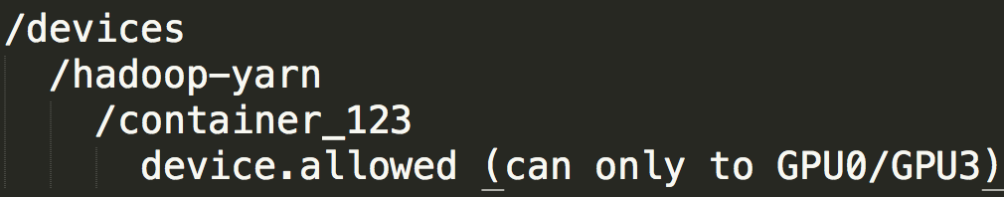
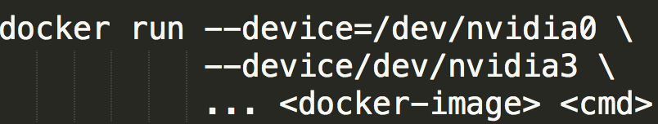
GPU support on YARN (Apache Hadoop 3.1.0)
Why need isolation?
Multiple processes use the single GPU will be:
Serialized.
Cause OOM easily.
GPU isolation on YARN: .
Granularity is for per-GPU device.
Use Cgroups / docker to enforce the isolation.
Notes:
Even though TF provide options to use GPU memory less than whole device provided. But we cannot enforce this from external.

Slide 25
Docker + GPU support on YARN (Apache Hadoop 3.1.0)
Most of machine learning platforms has python/R/cudnn/CUDA dependencies.
Docker solves messy dependencies issues
But it may introduce problems for GPU base libraries
Nvidia-docker-plugin mounts Nvidia driver, etc. when container got launched.
YARN supports Docker and as well as nvidia-docker-plugin.
Notes:
Even though TF provide options to use GPU memory less than whole device provided. But we cannot enforce this from external.

Slide 26
Solutions with YARN 3.x
Handle data access.
Do ETL efficiently.
Handle job dependencies.
Multi-tenant.
Do experiments easily.
Run production jobs easily.
Manage models
DL issues.
How about DL issues?

Slide 27
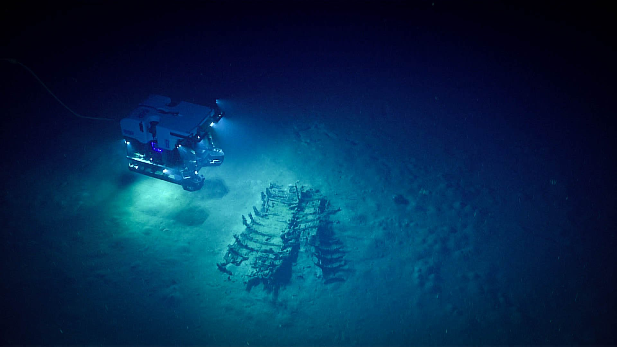
Hadoop {Submarine} Project
The only machine can take human to deep
Image courtesy of the NOAA Office of Ocean Exploration and Research, Gulf of Mexico 2018.

Slide 28
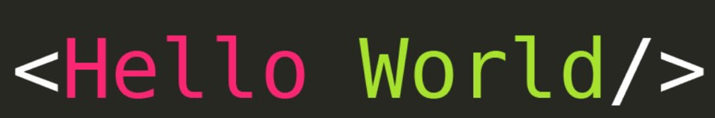
{Submarine} - “Launch distributed TF job like hello world”
(Only prerequisite) Setup a YARN cluster (3.1.0+).
Run distributed TF training with one command:
yarn jar hadoop-yarn-applications-submarine-<version>.jar job run \ --name tf-job-001 --docker_image <your docker image> \ --input_path hdfs://default/dataset/cifar-10-data \ --checkpoint_path hdfs://default/tmp/cifar-10-jobdir \ --num_workers 2 \ --worker_resources memory=8G,vcores=2,gpu=2 \ --worker_launch_cmd "cmd for worker ..." \ --num_ps 2 \ --ps_resources memory=4G,vcores=2,gpu=0 \ --ps_launch_cmd "cmd for ps"
Notes:
TODO: add slides about how easy it is to use submarine.

Slide 29
{Submarine} – “View your jobs history like a king/queen”
Run a service to monitor all TF job’s training progress in one tensorboard dashboard with one command.
yarn jar hadoop-yarn-applications-submarine-<version>.jar job run \ --name tensorboard-service-001 --docker_image <your docker image> \ --tensorboard

Slide 30
{Submarine} - “Cloud Notebook for Data Scientists”
Run a notebook (like Zeppelin) leveraging GPU with one command
yarn jar hadoop-yarn-applications-submarine-<version>.jar job run \ --name zeppelin-note—book-001 --docker_image <your docker image> \ --num_workers 1 \ --worker_resources memory=8G,vcores=2,gpu=4 \ --worker_launch_cmd "/zeppelin/bin/zeppelin.sh" \ --quicklink Zeppelin_Notebook=http://master-0:8080
Notes:
TODO: add slides about how easy it is to use submarine.

Slide 31
{Submarine} - “Same hello world examples for MXNet/Pytorch”
Run MXNet/PyTorch training with one command:
yarn jar hadoop-yarn-applications-submarine-<version>.jar job run \ --name xyz-job-001 --docker_image <your docker image> \ --input_path hdfs://default/dataset/cifar-10-data \ --checkpoint_path hdfs://default/tmp/cifar-10-jobdir \ --num_workers 1 \ --worker_resources memory=8G,vcores=2,gpu=2 \ --worker_launch_cmd “cmd for MXNet/PyTorch"
Notes:
TODO: add slides about how easy it is to use submarine.

Slide 32
Solutions with Submarine
Handle data access.
Do ETL efficiently.
Handle job dependencies.
Multi-tenant.
Do experiments easily.
Run production jobs easily.
Manage models
Handled by Submarine

Slide 33
Other interesting points / data

Slide 34
Does running in Docker means poor performance?
… In conclusion, even though there are extra layers lying between applications and hardware resources by using docker containers, docker engine manages to minimize the overhead pretty well. We don’t find noticeable drawbacks of docker containers in CPU and GPU tests …
Performance Evaluation of Deep Learning Tools in Docker Containers. (Pengfei Xu, et al, 2017)
But it is still very important to understand bad combination of Docker / OS leads to performance and debuggability issues.

Slide 35
Why GPU is necessary?
https://azure.microsoft.com/en-us/blog/gpus-vs-cpus-for-deployment-of-deep-learning-models/

Slide 36
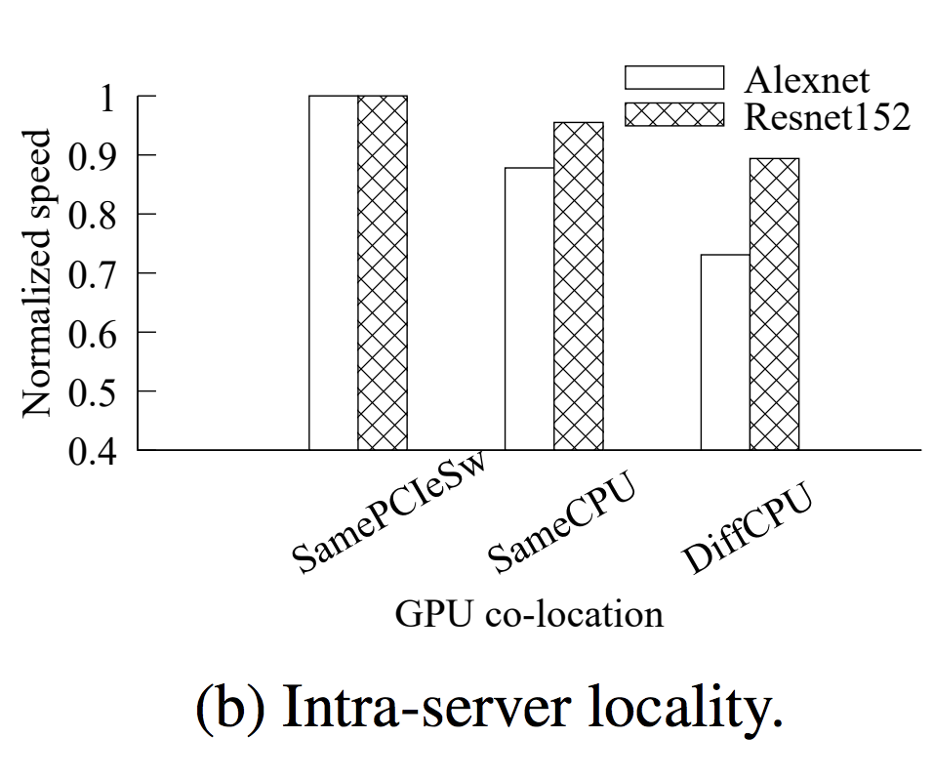
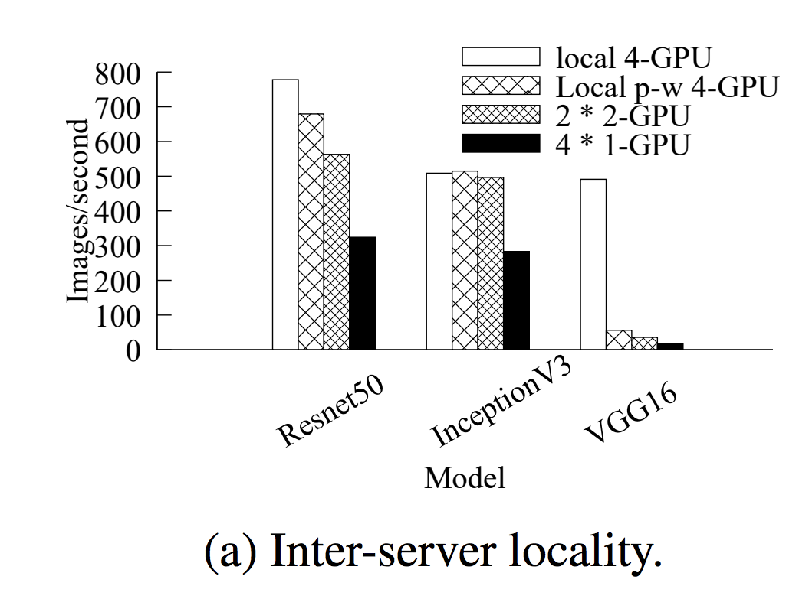
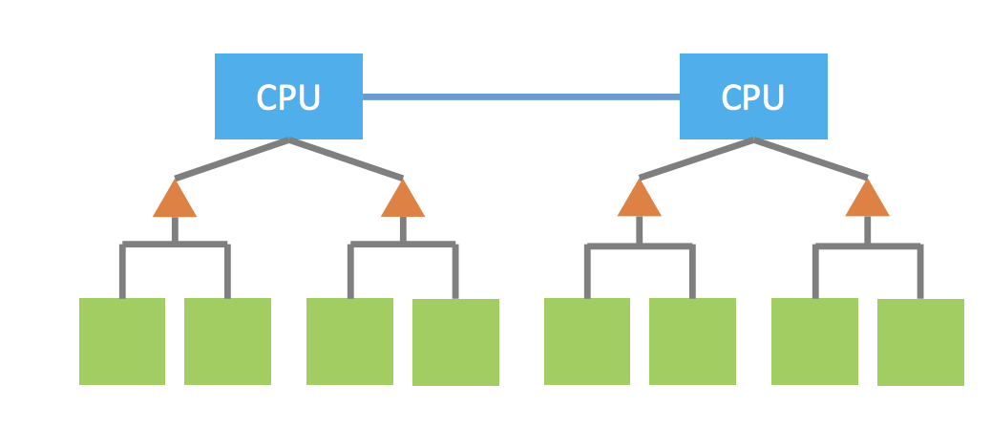
GPU hierarchical placement, is it important?
CPU/GPU architecture
All You Need to Know about Scheduling Deep Learning Jobs. (Wencong Xiao, 2017 SOSP)

Slide 37
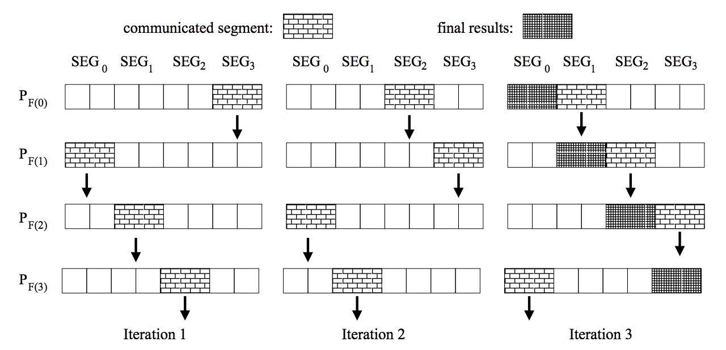
How to handle and tune #PS for distributed training?
Uber’s blogpost [1] mentioned two issues:
Identifying the right ratio of worker to parameter servers: Network overhead, etc.
Handling increased TensorFlow program complexity
There’s no static answer for this parameter.
Instead, world is moving towards all_reduce, which can achieve better performance and easier maintenance. [1]/[2]/[3]
Bandwidth Optimal All-reduce Algorithms for Clusters of Workstations. (Patarasuk/Yuan 09)
[1] https://eng.uber.com/horovod/, [2] tf.contrib.distribute.DistributionStrategy
[3] https://github.com/tensorflow/tensorflow/tree/master/tensorflow/contrib/distribute

Slide 38
Next steps

Slide 39

Status & Plans
Alpha solution is merged to trunk. (part of 3.2.0 release), still under active dev/testing. Umbrella JIRA: YARN-8135. (We need contribution!)
Submarine can run on Apache Hadoop 3.1+.x release. (HDP 3.0+). A single jar.
Supported runtime of YARN native service to train use Docker container.
Netease is validating Submarine in a 20-nodes GPU cluster, and plan to roll it to a 500 GPU cluster after validation. (Main driver: utilization, maint cost).
is working on an adaptor to make TonY (https://github.com/linkedin/TonY ) as a runtime of Submarine.

